Slide 1

12
Lecture
Information
Security
Notes:
http://www.nd.edu/~networks/Image%20Gallery/Large%20Images/eick1_lg.png
http://www.sxc.hu/browse.phtml?f=download&id=352344

Slide 2
Today’s lecture outline
Basic security terminology
Malware---attacks on integrity and confidentiality
Viruses, Trojan Horses, Spyware and Key-loggers
Spoofing attacks---attacks on authenticity
URL, DNS, IP, MAC, Email/ Caller ID spoofing
Network-based attacks---attacks on availability
DoS attack, worms
Social engineering attacks
Phishing, greetings card, lottery win, etc.
How to protect/mitigate against these attacks?
Firewall, Anti-virus, Precautions, Best practices

Slide 3
Basic terminology
1
Security jargon
Vulnerability, threat, attack;
Hacker, cracker;
Black hats versus White hats

Slide 4
Information Security Basics
“CIA” triad of security requirements:
Confidentiality (Privacy)
Integrity (Authorization)
Availability
Other core security requirements:
Authenticity
Non-repudiability

Slide 5
Malware
2
The software that is written for malicious purposes
Viruses
Trojan Horses
Spyware
Keyloggers
Ransomeware
Notes:
http://atom.smasher.org/error/gallery/

Slide 6
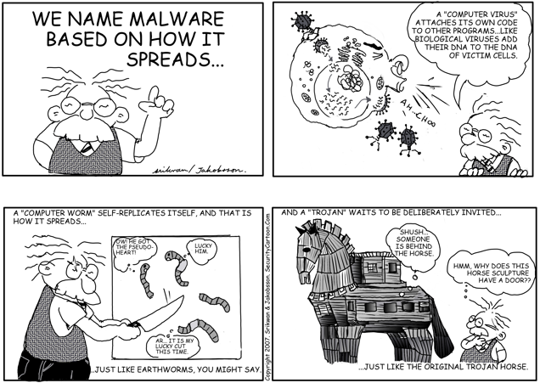
Reproduced with permission. Please visit www.SecurityCartoon.com for more material

Slide 7
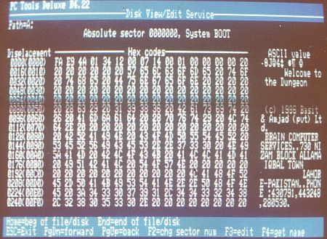
The first computer virus
Brain Virus (Pakistani Flu) 1986
Created by Amjad Farooq Alvi & Basit Farooq Alvi in Lahore
Credit: http://en.wikipedia.org/wiki/Brain_(computer_virus)

Slide 8
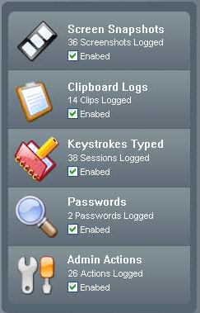


Key-loggers and Spyware
Notes:
http://www.alibaba.com/product/prolech-11475911-10943255/KeyShark_Hardware_Keylogger.html
http://www.illinoisicac.org/images/spy.gif

Slide 9
Spoofing Attacks
3
where the attacker impersonates some one else
Email spoofing
URL spoofing
DNS spoofing
IP spoofing
MAC spoofing

Slide 10
Email Spoofing (phishing)
3.a

Slide 11
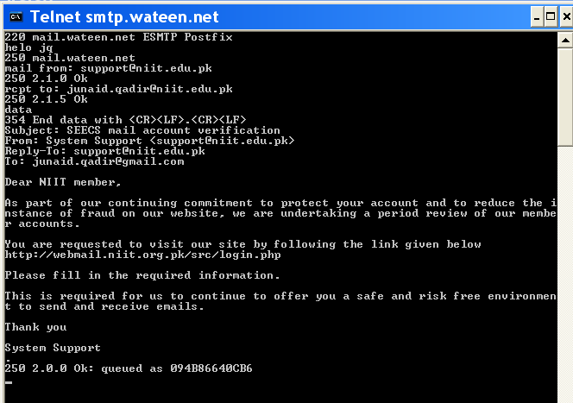

Slide 12
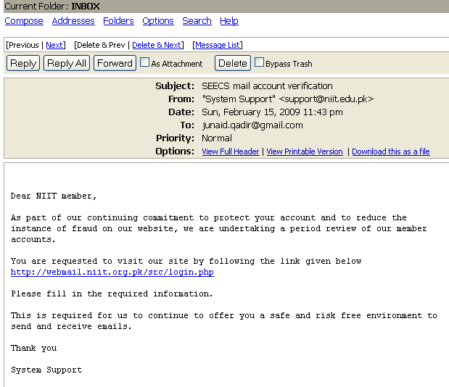

Slide 13
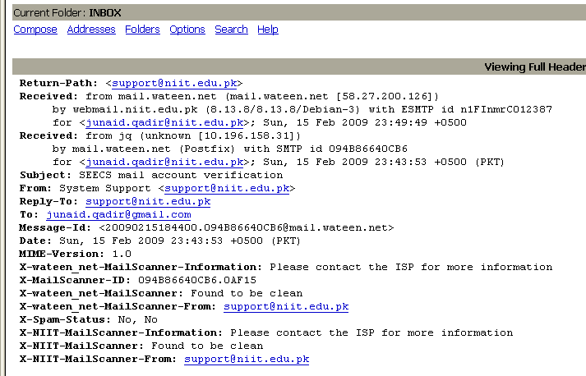

Slide 14

URL Spoofing (phishing)
3.b

Slide 15
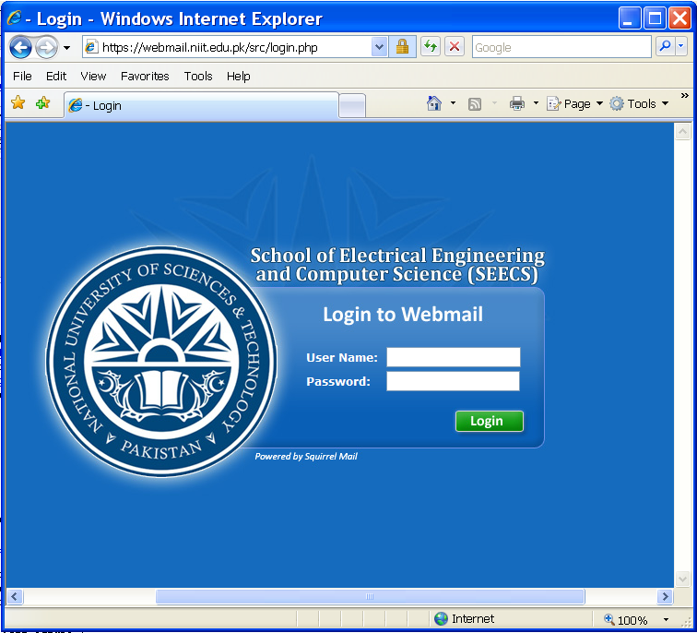
1
https://webmail.niit.edu.pk/src/login.php
Genuine URL;
Site: niit.edu.pk; directory: src;
file: login.php

Slide 16
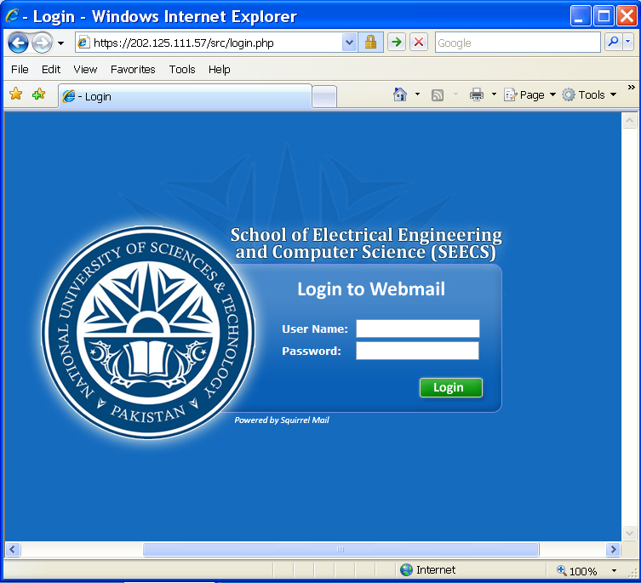
https://webmail.niit.org.pk/src/login.php
https://webmail.niit.org.pk/src/login.php
2
The second-level domain is .org and not .edu; faked website
HACKED
HACKED
HACKED
Victim.ID
**************

Slide 17
https://webmail.niit.edu.tk/src/login.php
https://webmail.niit.edu.tk/src/login.php
The first-level domain is .tk and not .pk; faked website
3
HACKED
HACKED
HACKED
Victim.ID
**************

Slide 18
https://202.128.111.87/src/login.php
https://202.125.111.57/src/login.php
The IP address does not correspond to webmail.niit.edu.pk; faked website
HACKED
HACKED
HACKED
4
Victim.ID
**************

Slide 19
DNS Spoofing
3.c
3.d
IP Spoofing
3.e
MAC Spoofing

Slide 20

DNS spoofing
DNS
WWW
Request
WWW
Tell me the IP address of www.niit.edu.pk?
Notes:
Hacker image from: http://english.vietnamnet.vn/dataimages/200611/original/images1168407_hacker.jpg

Slide 21
DNS spoofing
DNS
WWW
Reply
WWW
The IP address of www.niit.edu.pk is 110.125.157.198
The IP address of www.niit.edu.pk is 110.125.157.198
Fake NIIT site

Slide 22
MAC/ IP spoofing
Private network
192.168.1.0/24
00:aa:bb:cc:dd:ee:ff
.254
…
Malicious node
.1
.254
The malicious node can pretend to be another node
00:aa:bb:cc:dd:ee:ff
Notes:
IP spoofing is pretending to have someone else’s IP address.
In the scenario above, it can be that that private network is configured to allow only limited access (based on IP address or MAC address).
An intruding/ malicious node can attack both by claiming to have an IP address/ and or MAC address it does not have.

Slide 23
Network-based attacks
4
where the attacker pretends to be something he/she/it is not
Worms
Denial of Service attacks

Slide 24
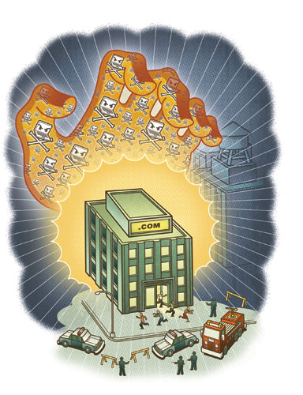
Denial of Service attacks
Notes:
http://www.ddosinfo.com/images/Attack%20of%20the%20bots_1.jpg
http://cyberwarfaremag.files.wordpress.com/2008/11/computer-worm-01.jpg

Slide 25
Social Engineering
5
Targets the weakest component of a security system---the users

Slide 26
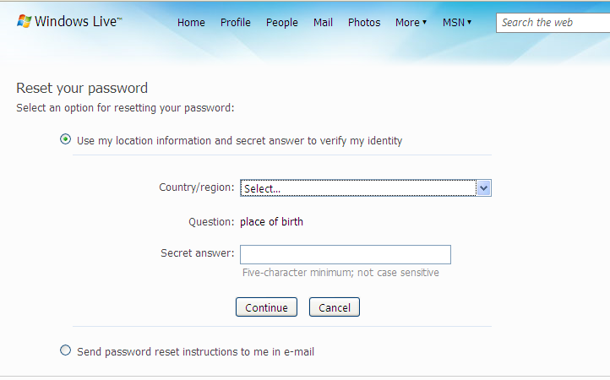
Non-technical hacking

Slide 27
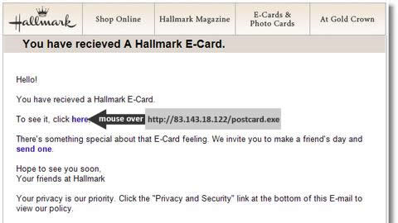
Greeting card phishing
Notes:
http://blog.activeservers.com/content/binary/hallmark2.jpg

Slide 28
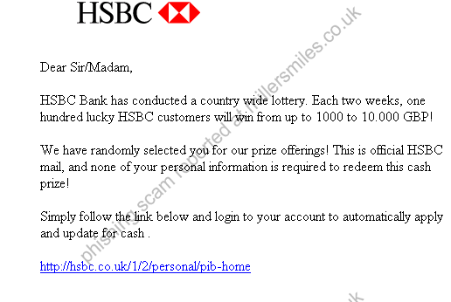
Lottery winning phishing
Notes:
http://www.millersmiles.co.uk/report/2698

Slide 29
How to protect against security attacks?
6

Slide 30
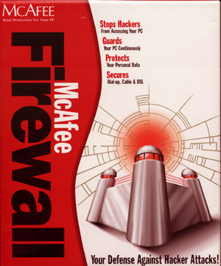
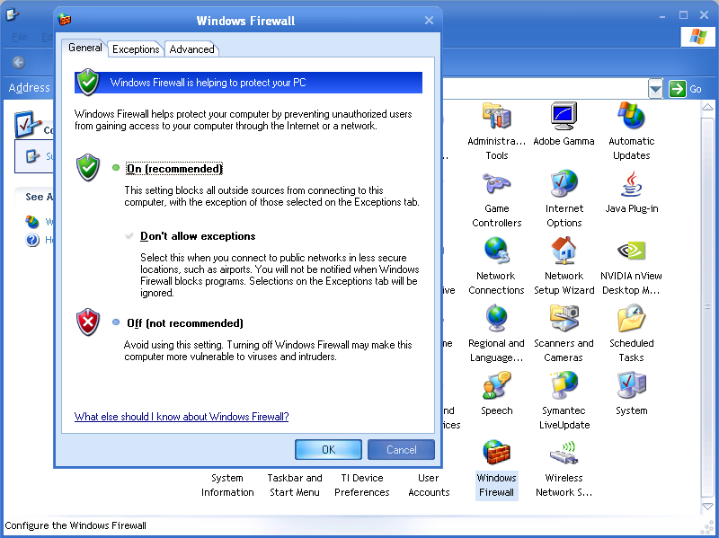
Use an Internet Firewall

Slide 31
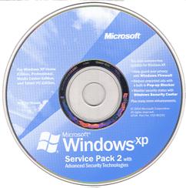
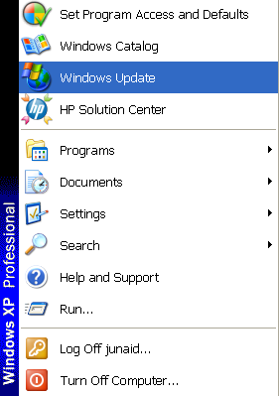
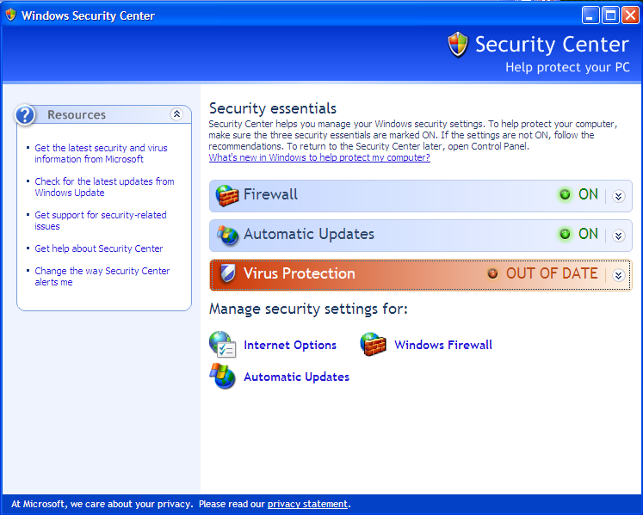
Apply the latest updates

Slide 32
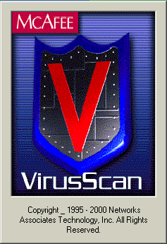
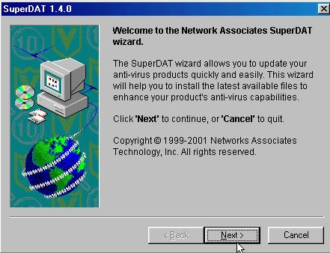
Use up-to-date Anti-virus
Notes:
Adapted from http://www3.uwm.edu/security/

Slide 33
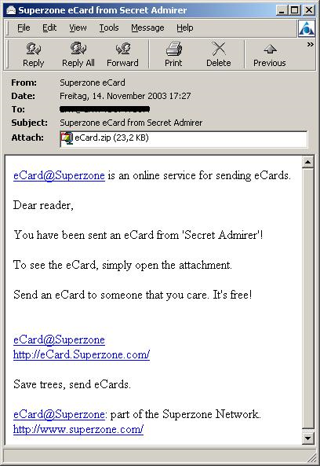
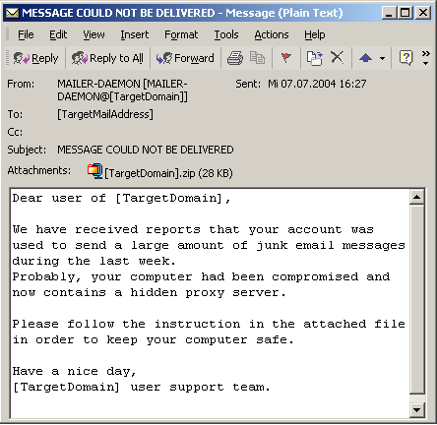
Opening trusted files only
X
X

Slide 34
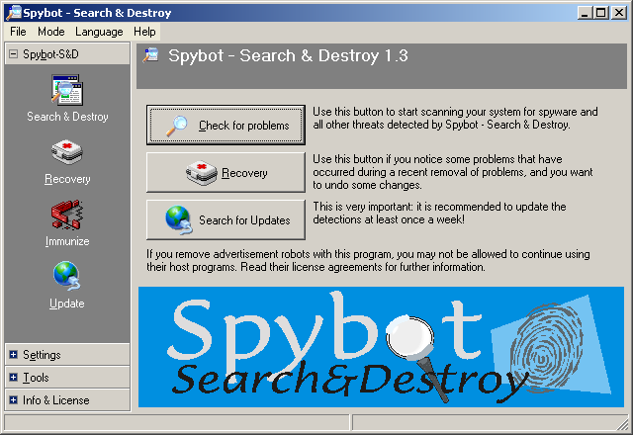
Protecting against spyware

Slide 35
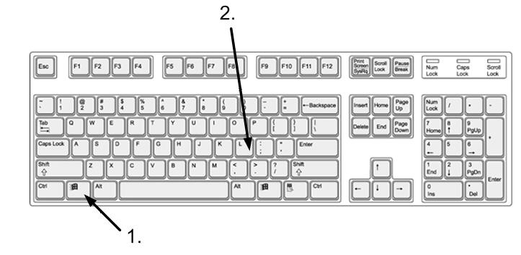
Passwords and locking systems when unused

Slide 36
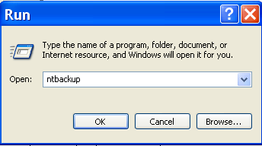
Backing up data

Slide 37
Security protection---Recall
Using an Internet Firewall
Installing the latest OS updates
Using Antivirus with updated virus database
Opening trusted files only
Protecting against spyware
Using good passwords and locking system

Slide 38
Conclusions
Basic security terminology
Malware---attacks on integrity and confidentiality
Viruses, Trojan Horses, Spyware and Key-loggers
Spoofing attacks---attacks on authenticity
URL, DNS, IP, MAC, Email spoofing
Network-based attacks---attacks on availability
DoS attack, worms
Social engineering attacks
Phishing, greetings card, lottery win, etc.
How to protect against these attacks?
Firewall, Anti-virus, Education, Precautions, Best practices
Conclusions

Slide 39
?
?
?
Questions/ Confusions?
Credits/ Acknowledgement can be found at the course website: http://tinyurl.com/5hb8pp

